Slide 1
Chicago Police Department Project December 4th, 2018 a Group 2: Jaieu Sheil, Keith Pallo, Eric Yang
EECS 339 – Data Science

Slide 2
Goal
Identify “Repeat Offenders” within the law enforcement system

Slide 3
Motivations
Bifurcation of Mistreatment
Inadvertent Protections & Systematic Hiding
Greatest Long Term Risks of Officer Population
Understanding the behavior of repeat offenders has a large upside for both law enforcement and the citizens it governs

Slide 4
Main Metric: Average Allegations per Year
Much larger than expected
Bifurcation of “Raw” Number of allegations was higher than expected – sought out normalization

Slide 5

Normalization By Computing District Level Metrics
Percent of Officers vs. Average Number of Allegations per Year
Percent of Officer
Average Number of Allegations per Year
$$Normalized= \frac{Personal Number of Allegations (per yr)}{District Average Number of Allegations (per yr)}$$
This simple analysis allowed us to more effectively define “Repeat Offenders”

Slide 6
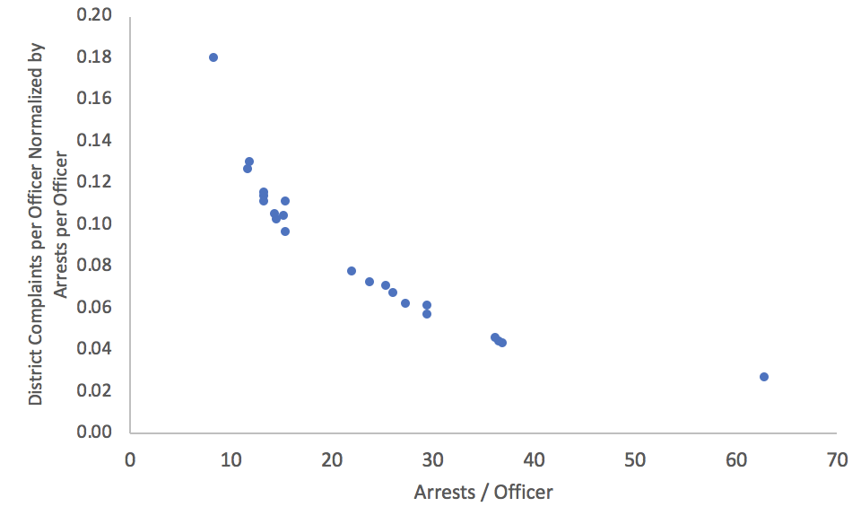
Additional Normalization With Arrest Data
Normalized Allegations (District Level) vs. Arrests per Officer
The general trend that we saw was unexpected and actually opposite to our intuition

Slide 7
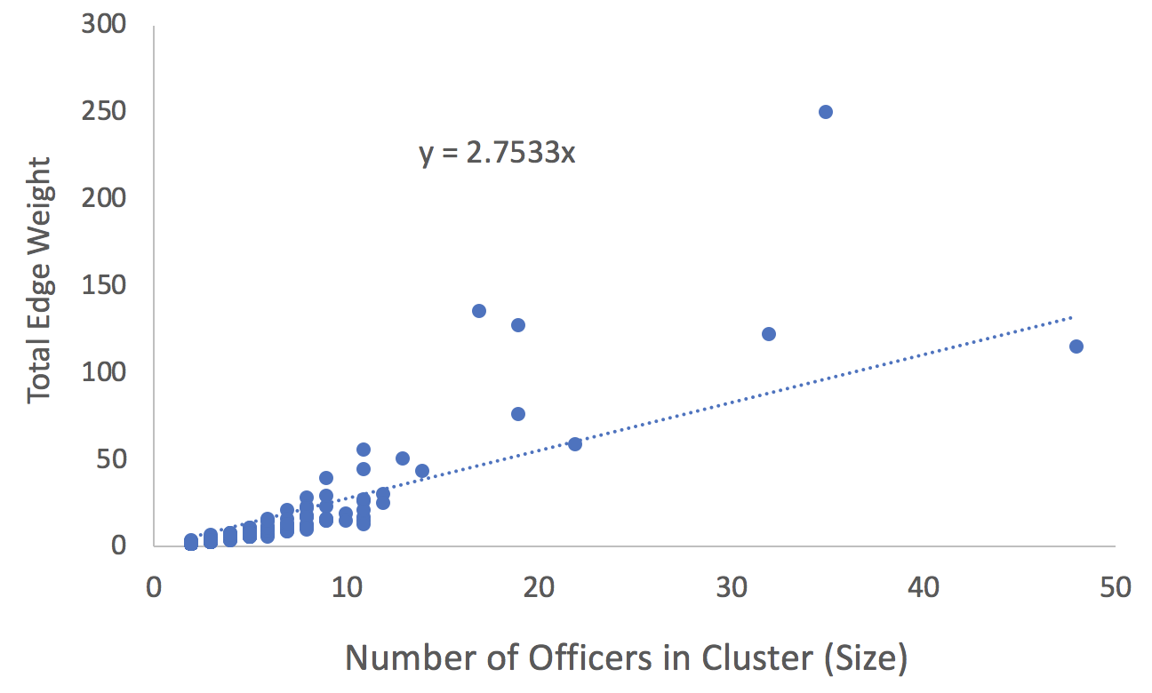
Co-Accusal Patterns By Connected Components Analysis
Aggregate Cluster Edge Weight vs. Size of Clusters
*1 Year Timeframe to avoid “Mega Clusters”
The general trend that we saw was expected – but specific clusters signified potential “collusion”

Slide 8
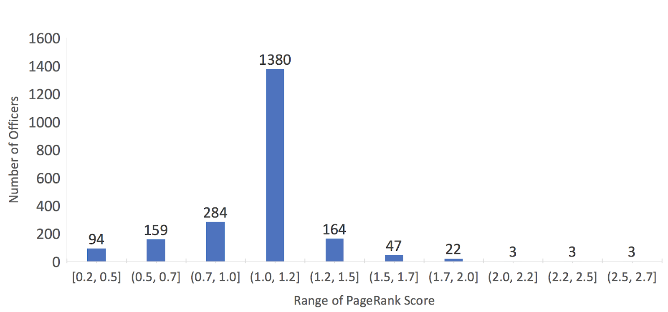
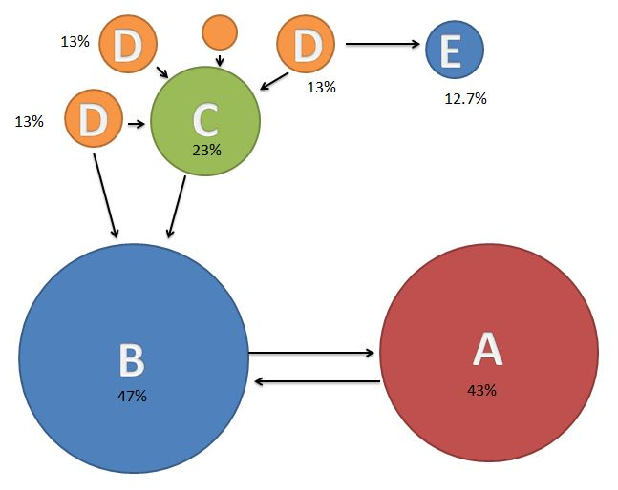
PageRank For Clustering and Component Connectedness
Number of Officers vs. PageRank Score
The very highly connected officers further explain our outliers on the previous slide

Slide 9
Machine Learning Models To Test Our Division of Officers
Team Analysis
Importance of Features
Average Allegation Count: 0.4296
Normalized Allegation Count: 0.2971
Number of Awards: 0.0988
Tenure: 0.0582
Age: 0.0393
Rank: 0.026
District Number: 0.0073
Gender: 0.0008
> 90% Match
> 93% Match
K-Means
GBD Forest
> 98% Match
*Analysis Completed with Spark ML
Surprised at insignificance of other features outside of allegation count

Slide 10
Incentive Effect of Disciplining Allegations
Significant Difference after discipline occurred
Officer Category | Overall Average Interval (Days) | Average Interval After Disciplined Allegation (Days) | Average Interval After Non-Disciplined Allegation (Days)
Repeat Offenders | 145 | 177 | 142
Non-Repeat Offenders | 398 | 481 | 393
It was reassuring to see a positive effect of disciplining after allegations

Slide 11
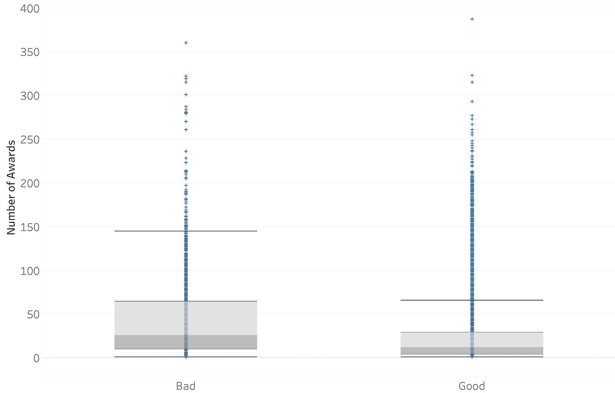
Awards Counts For Repeat and Non-Repeat Officers
Scatter Plot for Number of Awards (By Officer Segmentation)
*Repeat Officers categorized as ‘Bad’
Repeat Offending Officers do NOT have significantly lower number of total awards

Slide 12
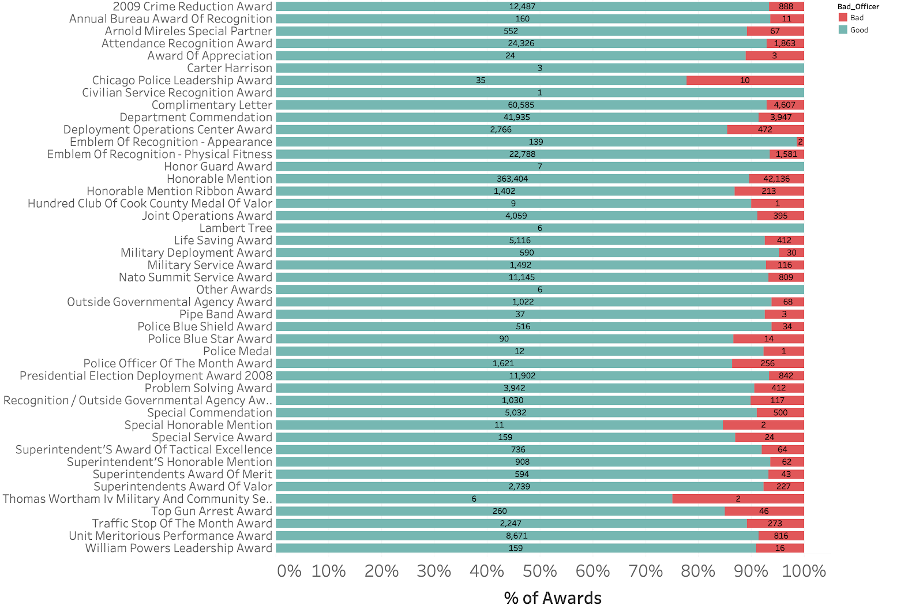
Award Distributions by Type
Awards by Type including Officer Segmentation
22% of Chicago Police Leadership Awards went to Repeat Offending Officers
25% of Thomas Wortham IV Military and Community Service Awards went to Repeat Offending Officers
Two rare awards have relatively high number of Repeat Offending Officers as awardees

Slide 13
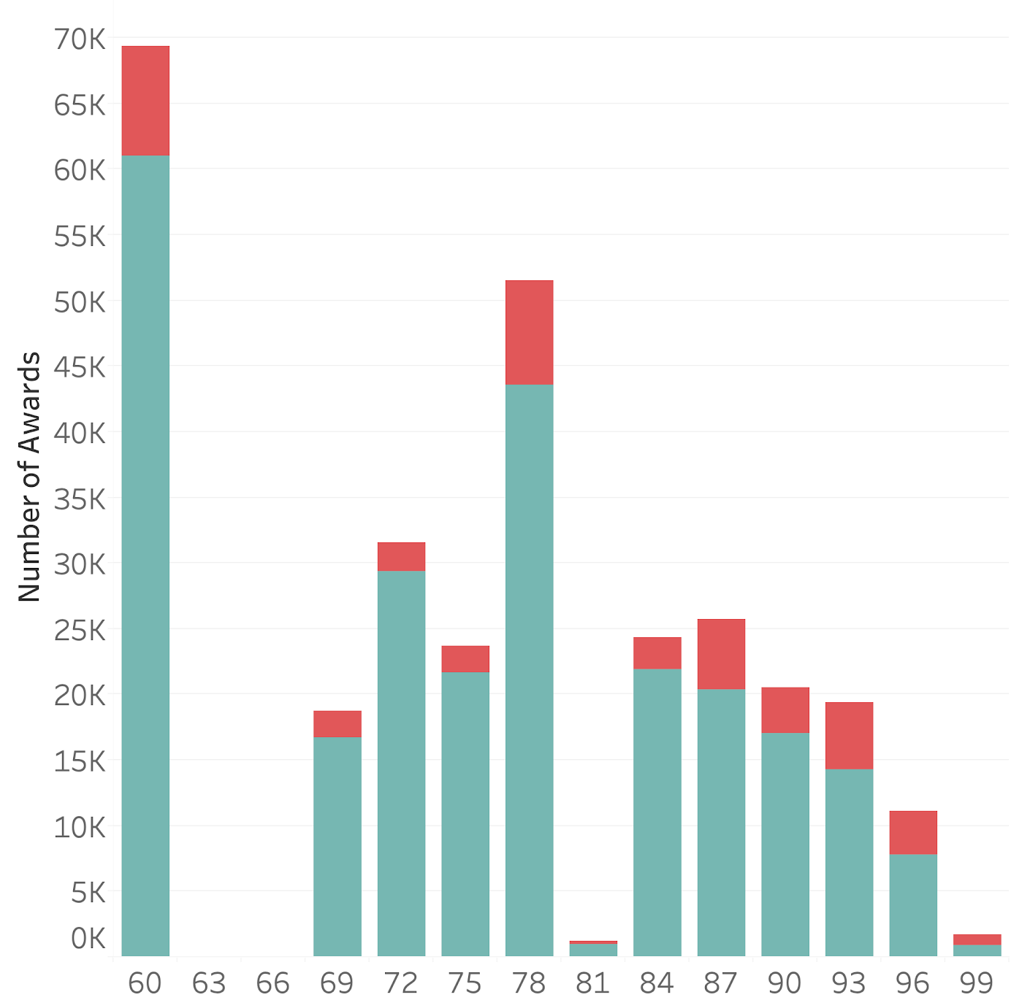
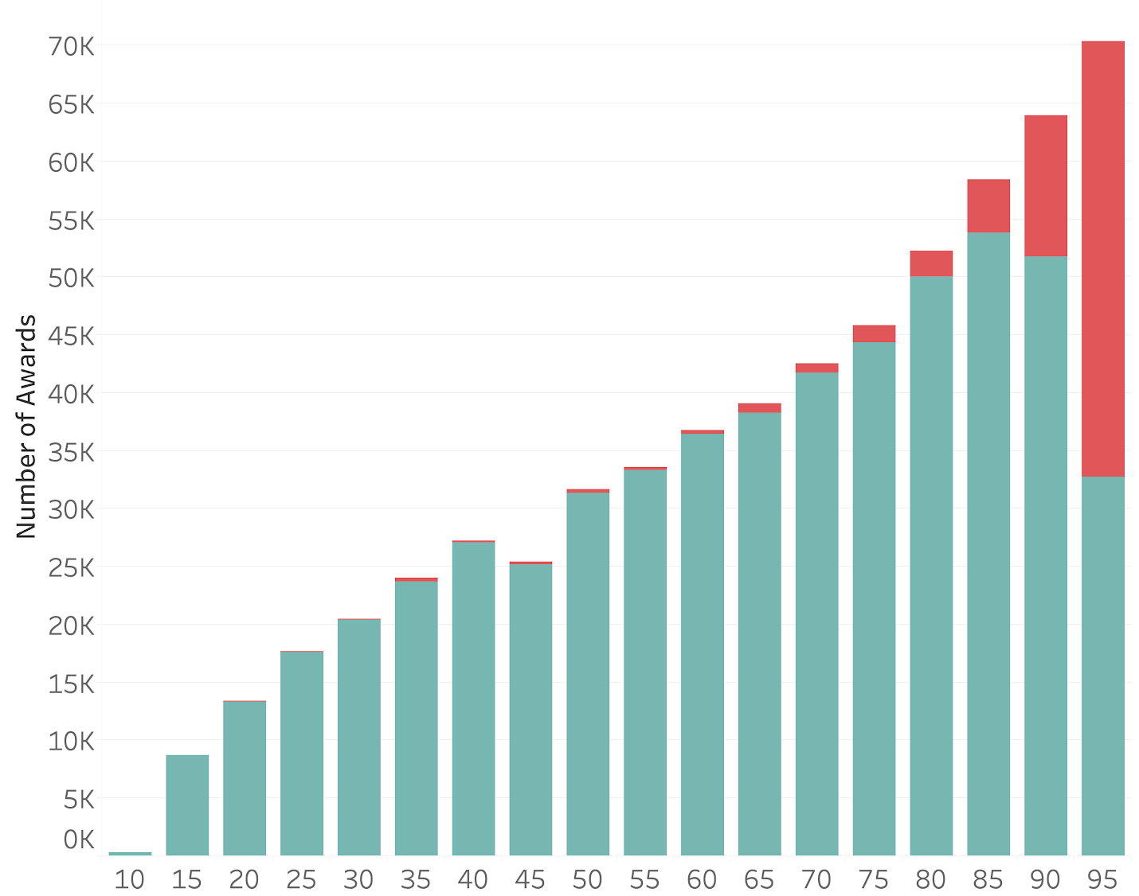
Award Distributions Across External vs. Internal Complaints
External Civilian Complaint Percentiles
Internal Allegation Percentiles
*Higher percentile indicates more complaints
Civilian complaints do not decrease odds of receiving awards – but actually seem to increase the chance of having a significant number of awards

Slide 14
Conclusions thus Far
Systematic Offenders Do Exist – Our analysis can assist with identifying potential offenders
Systematic ”Hiding” or Inadvertent Protection is still unclear
“Award” behavior is the most interesting find to date
The White Knight Principle may be occurring
Future Sets of Analysis
Diving Deeping on historical clustering trends
Further accounting for Settlement & Discipline (True Allegations)

Slide 15
APPENDIX

Slide 16
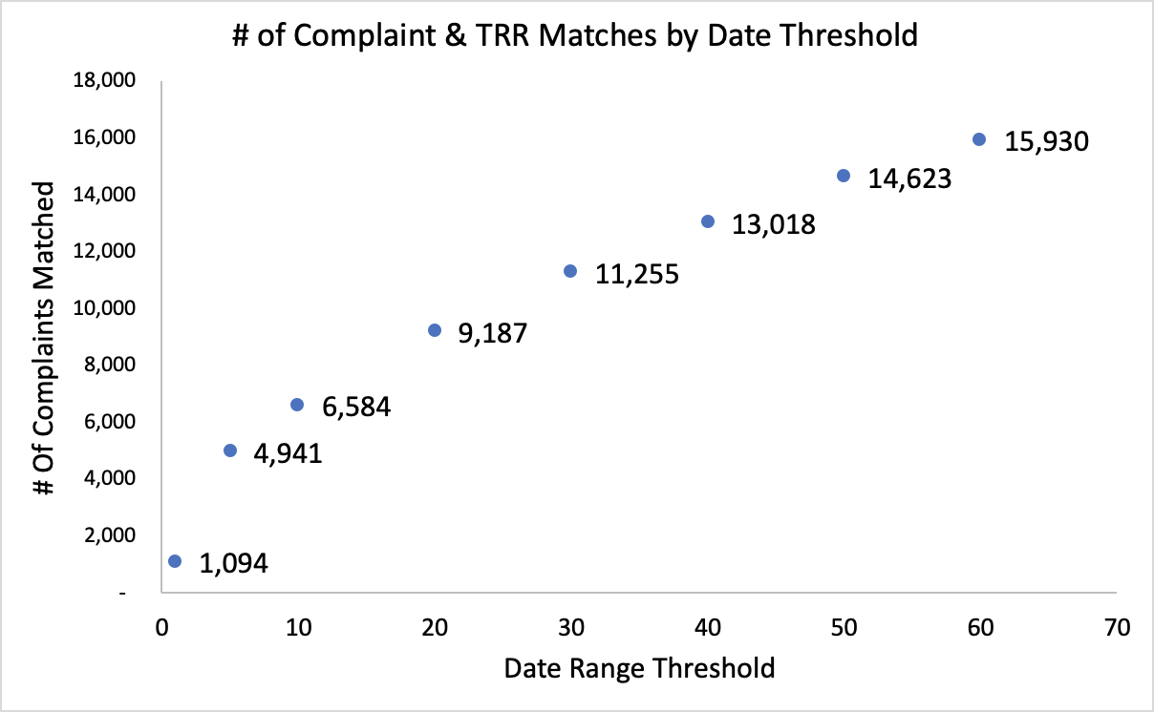
TRR reports matched with Allegations
Figure 1A: TRR Reports Matched vs. Date Match Threshold

Slide 17
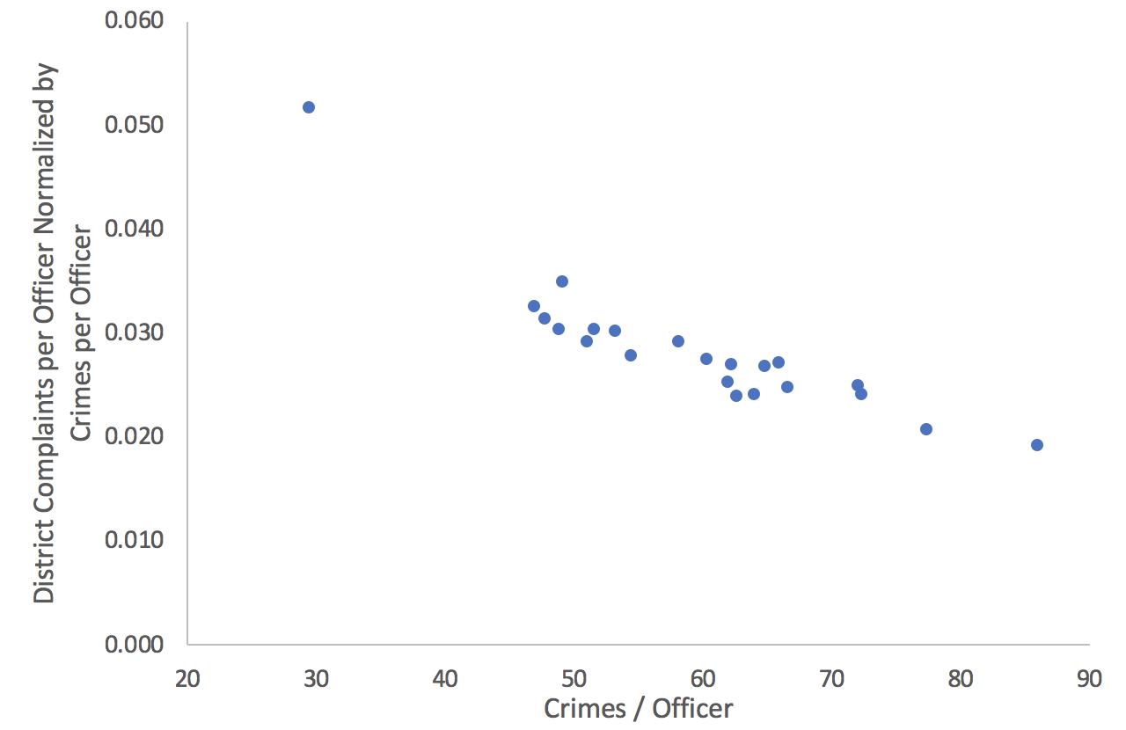
District Allegations Normalized by Crime Data
Figure 2A: TRR Reports Matched vs. Date Match Threshold
Similar to arrest trend and largely unexpected versus hypothesis

Slide 18
Other Interesting Facts – Allegation Analysis by Officer Position
Table 1A: Converted Allegation Analysis by Officer Position
Officer Position | False Allegations | True Allegation | % True of Total Allegation
Police Officer | 145695 | 13806 | 9%
Sergeant | 32877 | 2247 | 6%
Detective | 23323 | 1336 | 5%
Lieutenant | 7756 | 595 | 7%
Field Training Officer | 3511 | 226 | 6%
Captain | 1527 | 125 | 8%
Commander | 1330 | 62 | 4%
Deputy Chief | 506 | 20 | 4%
Chief | 269 | 8 | 3%
Director Of Caps | 90 | 2 | 2%
Deputy Superintendent | 59 | 1 | 2%
First Deputy Superintendent | 58 | 7 | 11%
Assistant Dep. Superintendent | 34 | 4 | 11%
Other | 25 | 1 | 4%
Assistant Superintendent | 20 | 2 | 9%
Superintendent Of Police | 19 | 1 | 5%
Superintendent'S Chief Of Staff | 1 | 0 | 0%

Slide 19
Other Interesting Facts – Complaints in Uniform
Table 2A: “Top” Officer Analysis Out of Uniform Complaints
Officer Number | Complaints On-Duty | Complaints Off-Duty | % Complains in Uniform
14400 | 61 | 1 | 98%
32105 | 56 | 0 | 100%
31030 | 49 | 4 | 92%
28968 | 48 | 3 | 94%
31795 | 47 | 1 | 98%
13873 | 46 | 10 | 82%
13605 | 45 | 1 | 98%
30091 | 43 | 3 | 93%
13778 | 43 | 2 | 96%
23132 | 42 | 5 | 89%
Officer Number | Complaints On-Duty | Complaints Off-Duty | % Complains in Uniform
2470 | 11 | 45 | 20%
15631 | 19 | 37 | 34%
32118 | 30 | 35 | 46%
10152 | 24 | 35 | 41%
25983 | 10 | 35 | 22%
31898 | 2 | 34 | 6%
10583 | 39 | 33 | 54%
28329 | 15 | 32 | 32%
32402 | 17 | 31 | 35%
25717 | 9 | 31 | 23%

Slide 20
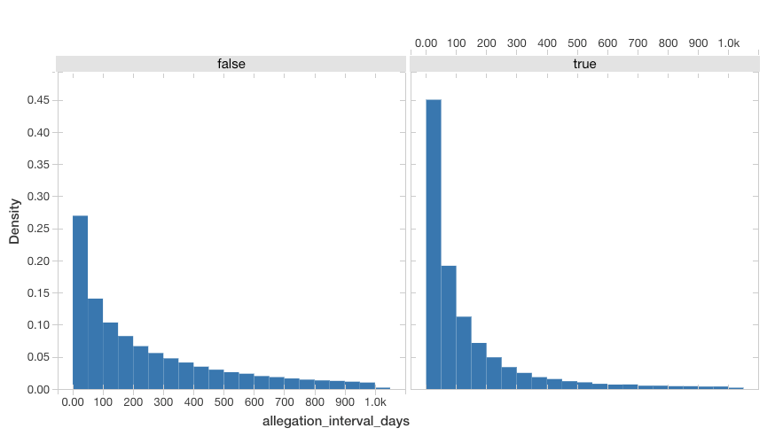
Interval Assessment
Figure 3A: Histogram of Interval B/W all complaints (Density vs. Allegation Interval Days)

Slide 21
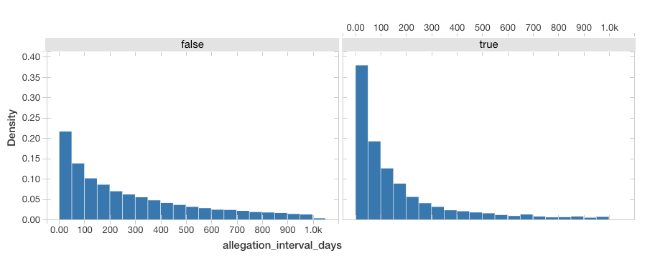
Interval Assessment
Figure 4A: Histogram of intervals between complaints after Disciplined complaints (days)

Slide 22
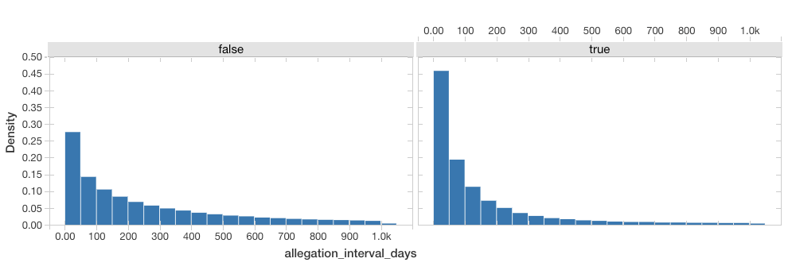
Interval Assessment
Figure 5A: Histogram of intervals between complaints after Non-Disciplined complaints (days)

